Slide 1

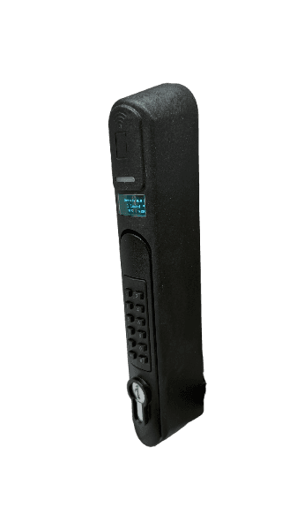


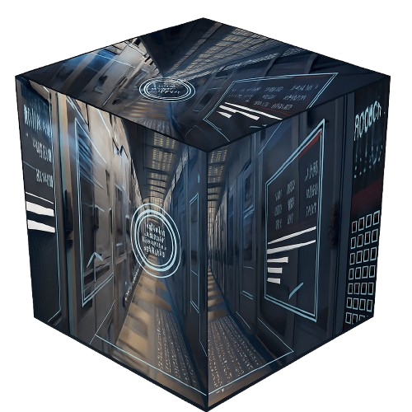
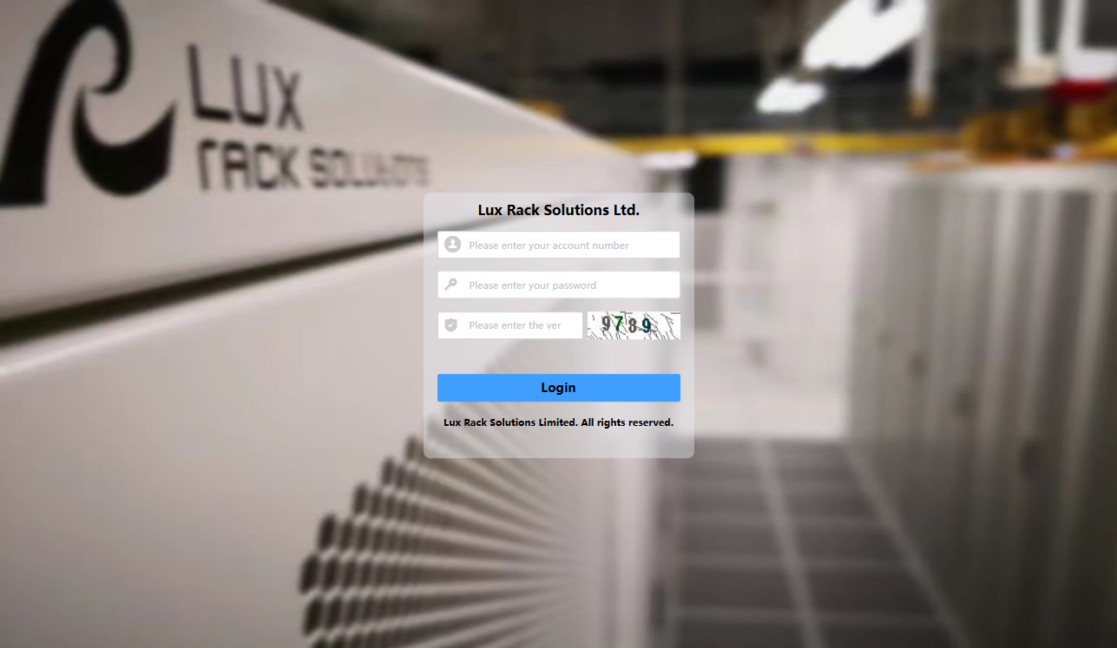

SmartGuard IoT Lock On Every Data Rack
The Last Line Physical Defence of Data Centre
Your Data’s Final Shield? The SmartGuard IoT Lock On Every IT Rack
KEY FEATURES
Electronic Handle Door Lock
Advanced Access Control
Real-time Doors Access Monitoring
Centralized Access Control
Audit Trail and Reporting
Visitor Management
User-Friendly Interface
Standalone Network
Brand-Neutral
Robust Physical Security
Address: Unit 20, 19/F, International Trade Centre, 11 Sha Tsui Road, Tsuen Wan, New Territories | DS-EL-20260901
Tel : +852- 3618 9188 Fax: +852- 3590 9009 Website: www.lux-rack.com Copyright Lux Rack Solutions Limited. © 2026 All right reserved.

Slide 2
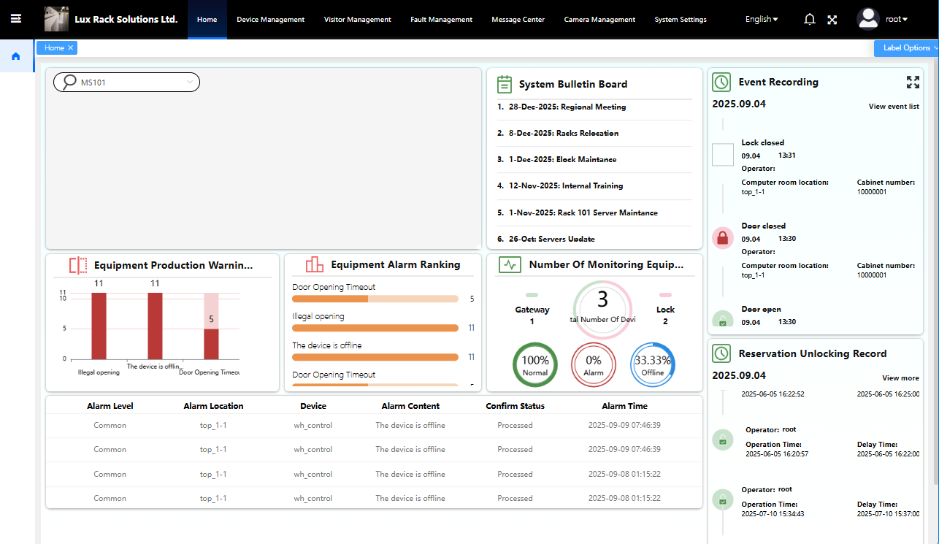
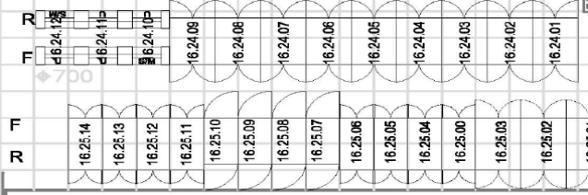
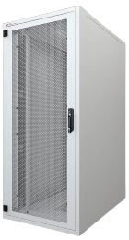




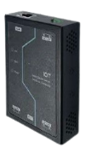
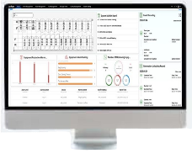

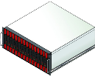
LUX RACK SMARTGUARD IOT LOCK SOLUTIONS FOR IT RACK
As AI servers and network switches process increasingly high-value, mission-critical data, the physical security of server/network racks has evolved from a "basic requirement" to a business-critical priority. This includes not just reliable locking mechanisms, but granular access control, immutable audit trails, and real-time visibility—all to mitigate risks of unauthorized access, data breaches, or operational disruptions.
Adapting server rack security to these demands is no longer optional: it is essential for ensuring AI workloads running efficiently, securely, and in compliance with global data protection regulations.
Introducing Lux Rack Solutions’ SmartGuard IoT Lock: Redefine Rack Security
We are proud to launch our SmartGuard IoT Lock Solutions for IT Server/Network Racks—engineered exclusively by Lux Rack Solutions to address the unique challenges of modern data centers. This revolutionary system fuses cutting-edge security technology with rugged durability, delivering unparalleled protection for your most valuable digital assets.
Wide-Ranging Applications
Ideal for deployment in:
1. Internet Data Centers (IDCs)
2. Enterprise computer rooms
3. Cloud/data centers
4. Any environment requiring remote unlocking capabilities (via integrated IoT connectivity or networked control systems) and real-time
monitoring to meet compliance requirements (e.g., GDPR, ISO 27001, GB/T 21556-2008).
Physical Layer
Control Layer
Transport Layer
Application Layer
RS485
TCP/IP
PN: LRSDS867
PN#: LRSA1408
SmartGuard IoT Lock Management Platform
SmartGuard IoT Lock
(door sensors)
IoT Controller
(wired controller)
Ethernet
(server / switches)
Address: Unit 20, 19/F, International Trade Centre, 11 Sha Tsui Road, Tsuen Wan, New Territories | DS-EL-20260901
Tel : +852- 3618 9188 Fax: +852- 3590 9009 Website: www.lux-rack.com Copyright Lux Rack Solutions Limited. © 2026 All right reserved.

Slide 3

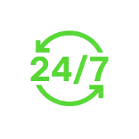


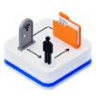




KEY FEATURES
SmartGuard IoT Lock solves these pain points by redefining data center security. Merging advanced access control, real-time monitoring, and industry-leading compliance, it ensures your critical infrastructure stays protected, traceable, and audit-ready 24/7—whether you operate locally or globally.
01
02
03
Advanced Access Control: Ditch Traditional Keys
Supports biometric authentication (fingerprint), smart cards (NFC), and PIN codes—layered options to fit your team’s workflow (mechanical key as option)
Real-Time Door Access Monitoring: Stay in Control 24/7
Sends instant alerts (email) for abnormal events (e.g., after-hours access, forced entry attempts)
Centralized Access Control: Manage Permissions Remotely
Customize access levels by user role (e.g., admin, technician, contractor) to avoid over-permission risks
04
05
06
Audit Trail and Reporting: Meet Compliance with Ease
Generates exportable reports (CSV/PDF) to streamline audit processes
Integrated Visitor Management: Approve Access Securely
Built-in Visitor Management module lets leaders review and approve visitor permissions
User-Friendly Interface: Simple to Operate, No Expertise Needed
No complex training required—get your team up and running in hours
07
08
09
Standalone Network: Minimize External Vulnerabilities
Operates independently to avoid risks from external access points
Brand-Neutral Design: Fit Any Existing Rack /universal compatibility:
Universal mounting design works with most global branded racks (e.g., IBM, HP, Dell, APC)
Robust Physical Security: Withstand Demanding Environments
Rugged construction and tamper-proof design resist forced entry, corrosion, and wear
ISSUES
Vulnerable to breaches: Lost keys, unauthorized access, and physical tampering put critical IT assets at risk. Wasteful manpower: On-site staff must escort personnel to racks just to unlock doors—draining resources. Unreliable tracking: Manual access logs are often incomplete, lost, or unauditable, failing to meet regulatory demands. Catastrophic consequences: A single breach can lead to massive financial losses, irreversible reputation damage, and non-compliance penalties.
BENEFITS
Enhanced Data Security: Mitigate risks of unauthorized access and data breaches via MFA, tamper alerts, and real-time monitoring—protecting sensitive data from internal and external threats. Improved Operational Efficiency: Streamline access control (no manual key management) and eliminate escort requirements—freeing up staff to focus on high-priority tasks. Compliance with Regulations: Meet Hong Kong’s PDPO, International Standards (ISO 27001) and Chinese National Standard (GB/T 21556-2008) with automated, auditable logs. Peace of Mind: Gain complete control over rack access with 24/7 monitoring and tamper-proof trails—resolve incidents faster and reduce operational anxiety. Social Distancing: Remote unlocking minimizes in-person interactions, protecting employees’ health during pandemics or high-health-risk periods.
Address: Unit 20, 19/F, International Trade Centre, 11 Sha Tsui Road, Tsuen Wan, New Territories | DS-EL-20260901
Tel : +852- 3618 9188 Fax: +852- 3590 9009 Website: www.lux-rack.com Copyright Lux Rack Solutions Limited. © 2026 All right reserved.

Slide 4
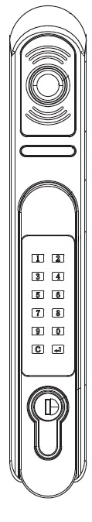
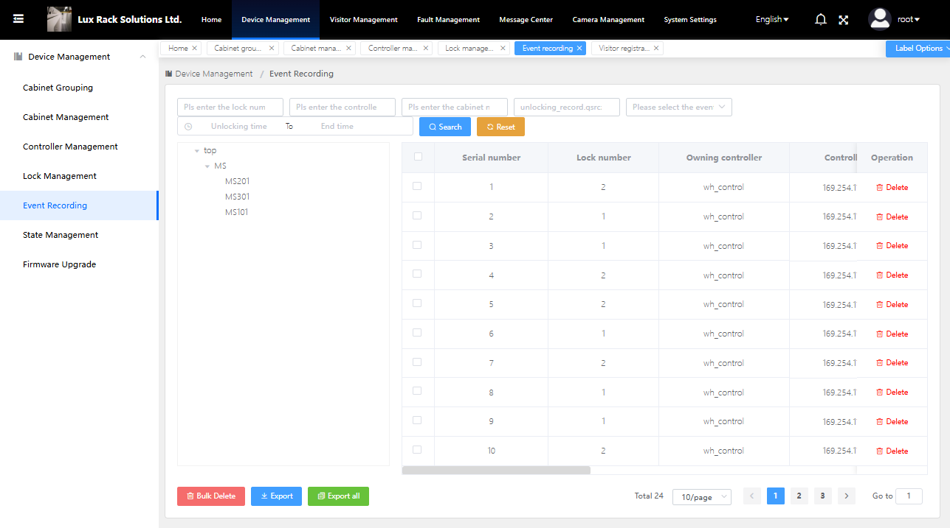
Why Choose Lux Rack SmartGuard IoT Lock?
✅ Eliminates unauthorized access to critical IT assets
✅ Simplifies compliance audits with automated, tamper-proof logs
✅ Cuts operational costs (no more on-site guard rounds for unlocking)
✅ Scales easily—supports up to thousands of racks per management system
✅ Aligns with data privacy and security guidelines
✅ Fits any existing rack (brand-neutral) to avoid costly replacements
✅ The system’s scalability will allow for future growth
SPECIFICATIONS
1 | Part Number: | LRSLDL867 (bundle of 2pcs x elock & 1pc x controller) LRSA1408 (1pc x controller only) LRSDS867 (1pc x elock only) | 10 | Unlock Method : | Remote IP Network / IC / Bluetooth / RS485 / Fingerprint / Password / Mechanical Key (optional)
2 | Overall Dimension: | 240*38*45mm | 11 | Password: | 6 digits
3 | Rated Voltage: | DC 12V ±10% | 12 | Lock Cylinder: | Mechanical & Electronic Lock Cylinder
4 | Rated Current: | ≤50mA | 13 | Weight: | 620g
5 | Peak Current: | ≤100mA | 14 | Door Hole Opening Size: | 124*24.5mm
6 | Working Temperature: | -10 ~ 65℃ | 15 | Material: | Nylon PA66 Zinc Alloy Carbon Steel
7 | Working Humidity: | 5 ~ 90% | 16 | Control Wire: | 400mm
8 | Communication Interface: | RS485, BLE | 17 | Controller: | Bundle with RS485 to IP Door Controller x 1pc per IT Rack
9 | IC Access Card Parameters Frequency | 13.56MHz (Card Type: IC / NFC) | 18 | Door Sensor: | Bundle with Door Sensor (for Front & Rear Door) x 1set per IT Rack
Contact Us
Ready to upgrade your data center security with benefits tailored to your needs?
Email: sales@lux-rack.com | Tel.: +852 3618 9188 | Website: www.lux-rack.com
SmartGuard —Where Data Center Security Meets Intelligence
All information and specifications are subject to change without notice.
Address: Unit 20, 19/F, International Trade Centre, 11 Sha Tsui Road, Tsuen Wan, New Territories | DS-EL-20260901
Tel : +852- 3618 9188 Fax: +852- 3590 9009 Website: www.lux-rack.com Copyright Lux Rack Solutions Limited. © 2026 All right reserved.

